Slide 1

UMBC Obsidian
Jerson Guansing
Victor Wu
Gene Burchette
Darren Stevens
Karl Justice

Slide 2
Description
UMBC Bazaar is a web application to buy, sell and trade goods or services which is similar to Craigslist.org or an online trading market. The intended audience is the development team and UMBC community.

Slide 3
Use Cases

Slide 4

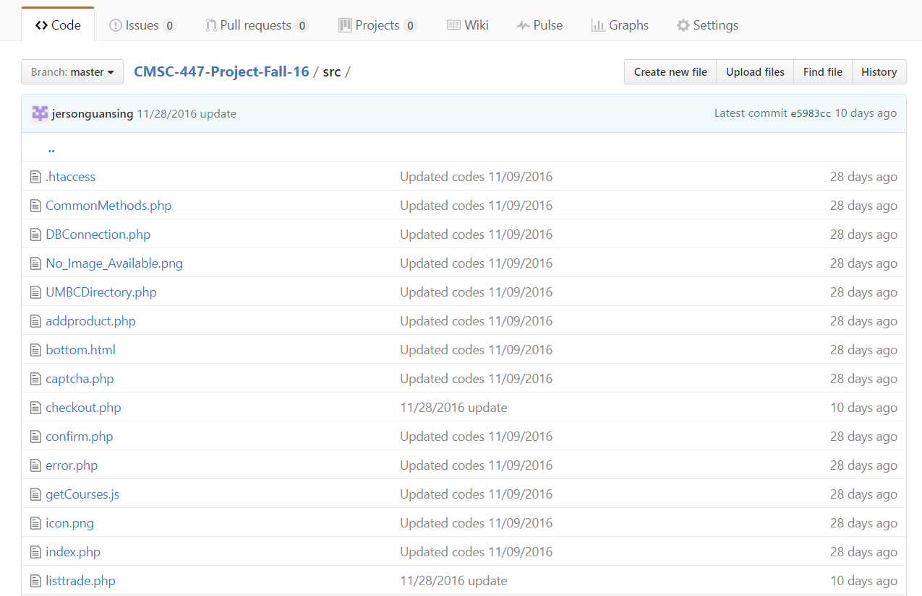

Project Components

Slide 5
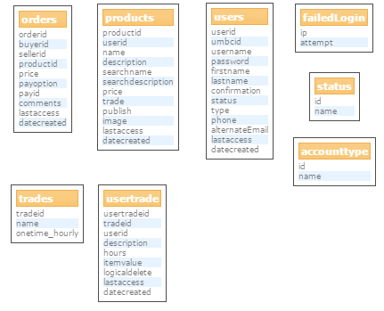


Project Components

Slide 6

Testing Procedures
Unit Testing - Testing both client and server-side functions, and intentionally passing invalid arguments to functions and HttpRequests.
Integration Testing - Making sure that PHP files are working as intended handling form submissions, database queries, and email notifications.
Try to force impossible states - Preconditions can’t be assumed

Slide 7
Setbacks and Recoveries
Planned features vs. Implementation
PayPal/Venmo -> Cash on Delivery, Trade Options
GL limitations/blocked ports -> private email server/VM
“Would you like anything else by this seller?”

Slide 8
Future Plans
For next Release-
User Ratings
Classifications/Tagging for better searching
More Robust Administrative tools

Slide 9
Demo

